Slide 1
Application Testing & Using
ServicePlus

Slide 2
ServicePlus
ServicePlus is a generic application to develop and provide an electronic delivery for all the services provided by The Government to The citizen. The Government of India, State Governments and Local Governments are providing various services to benefit the citizens at Centre, State or Local level primarily Government to Citizen (G2C) and Government to Business (G2B). The services provided by Government can be categorized as:
1. Regulatory Services: Regulatory services are services like trade licence, permit for construction of a building etc that can be denied by the Government.
2. Statutory Services: Statutory services are services like Issuance of Birth/Death certificate which cannot be refused by Government.

Slide 3
3. Developmental Services: Developmental Services are services or schemes provided by Government for the benefit of citizens such as Old age Pension .

Slide 4
Advantages of ServicePlus
1.Service(s) will be created online .
2. Citizens will be submitting applications online .
3. Service units will be able to receive application online .
4. Service units will be able to verify documents and application fee online .
5. Service units will be able to escalate application to some other person, in the case of absence of dealing authority, online .
6. Citizens will be monitoring Application status online .
7. As it is an online application,some dependencies , such as installing a setup to run the application , are reduced.

Slide 5
8.There is less chance of crashing of applications as it is more secured than offline applications.
9.The service is available where there is an internet connection.
10.Even if an application has been rejected , it can be undone with the callback functionality.

Slide 6
Framework
The ServicePlus eService delivery system runs on the following framework:
Front- End: Java.
Database: Postgress.
Server: Tomcat.
Operating System: Linux Redhat.
The main database and server of ServicePlus is situated in NIC New Delhi.

Slide 7
Support for Multiple Languages
Any service can be configured and made available in multiple languages
In particular, the following can be made available in local languages:
Application forms
Forms used by officials
Email & SMS notifications
Various documents/certificates generated as part of the service delivery process

Slide 8
Digital Signature
ServicePlus provides facility for digitally signing the documents.

Slide 9
Developing an Online Service in ServicePlus
Service Plus gives a very easy to use framework to build new online services, which includes:
Form Designer:
1. Provides an excellent Form Builder tool to design multi-lingual forms in minutes designed for applicants as well as officials.
2. Fields with built-in validations can be dragged & dropped.
Process Flow Designer:
1.The Service Definer can define the tasks and the flow between the tasks.
2.Each workflow player can have his own form for processing of a specific application.

Slide 10
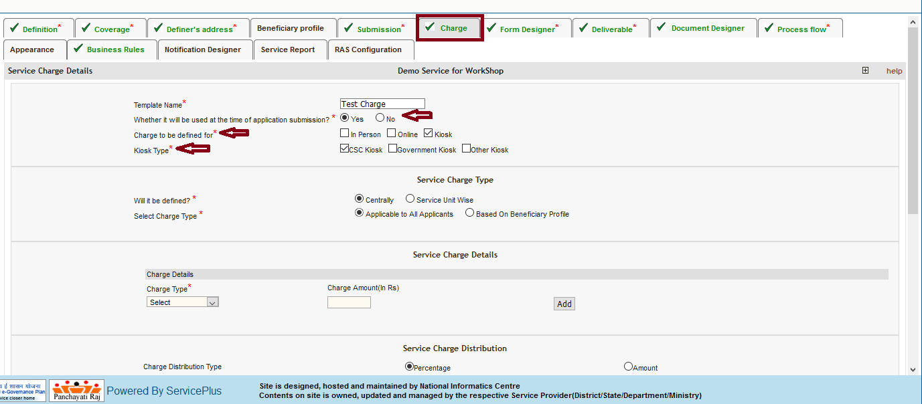
Demo Screen for developing a service

Slide 11
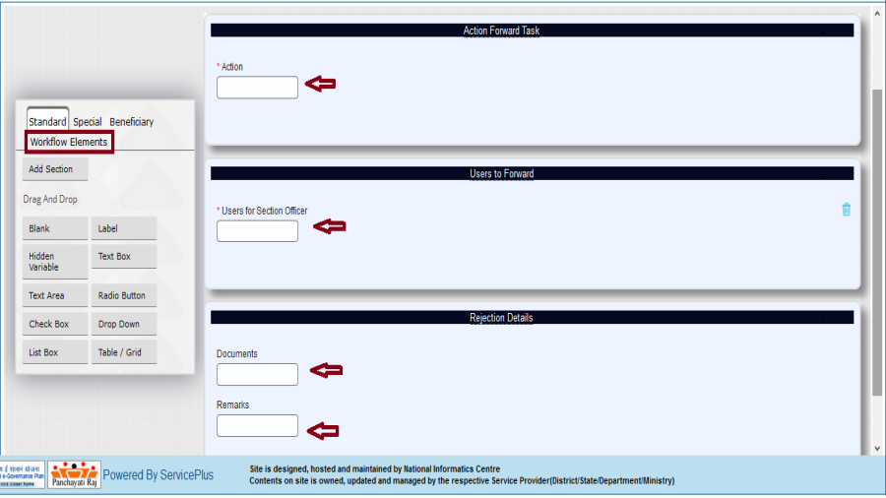
Form Designer

Slide 12
Notification Designer:
Notifications can be sent to mobile numbers and email IDs provided in the application form, registration form or to officials
Document Designer:
Document can be designed for custom acknowledgement, output certificate, rejection certificate, intermediate certificate, SMS and email notifications.
Service Charge:
A service can be configured to support multiple modes of payment including online, cash, DD, cheque etc.
Activating, Testing & Launching a Service:
1.ServicePlus supports selective activation of service units and launch of service only in the activated units.
2.A service configured in the production server can be tested end-to-end in the activated units.

Slide 13
Application Testing
In ServicePlus we tested the following services and found few bugs in them.
1.Issue of Primitive Tribe Certificate.
In the single window operator there was a minor bug in salutation, gender and relationship with guardian.
The application was accepting images other than the prescribed format.
An extra blank page was being produced in return slip, rejection slip as well as the output certificate.

Slide 14
Application Testing
2.Issue of Residential Certificate.
The application was accepting images other than the prescribed format.
Verification letter to the superintendent of police was having an extra blank page.
We also made the user manual for the same services which can be used by applicants and officials in the service units such as LDC and SDM.

Slide 15
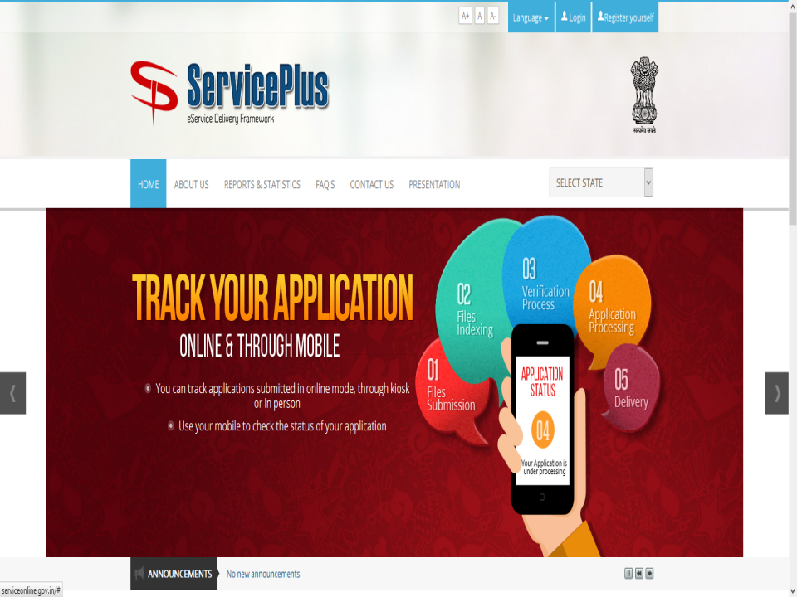
ServicePlus Homepage

Slide 16
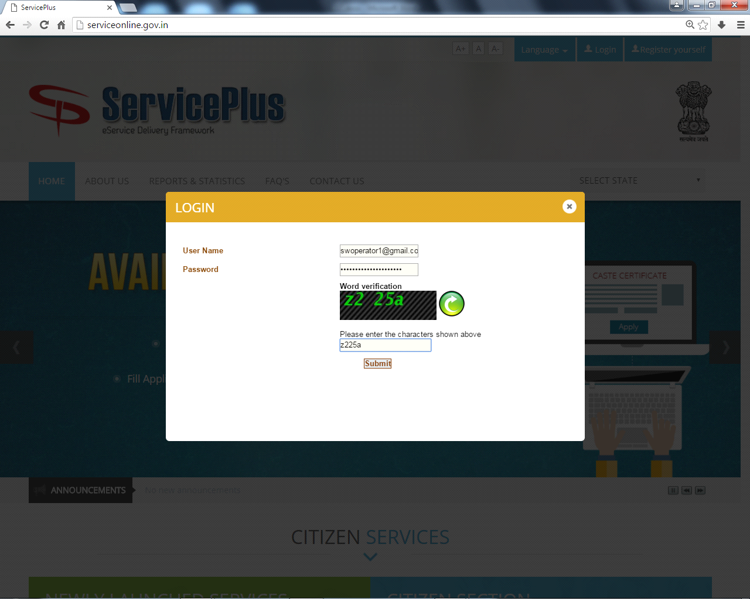
PROCEDURE TO APPLY FOR PRIMITIVE TRIBE CERTIFICATE
SINGLE WINDOW OPERATOR
Login

Slide 17
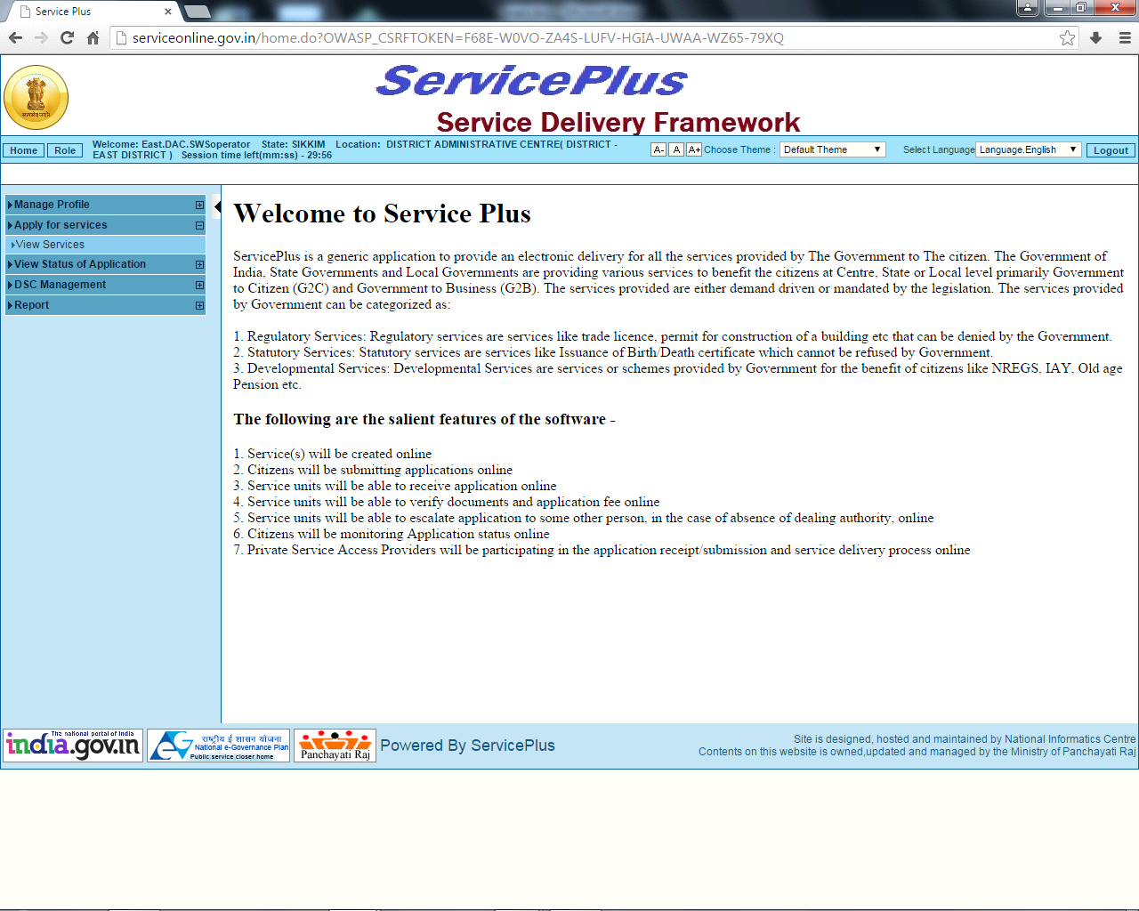
Home Page

Slide 18
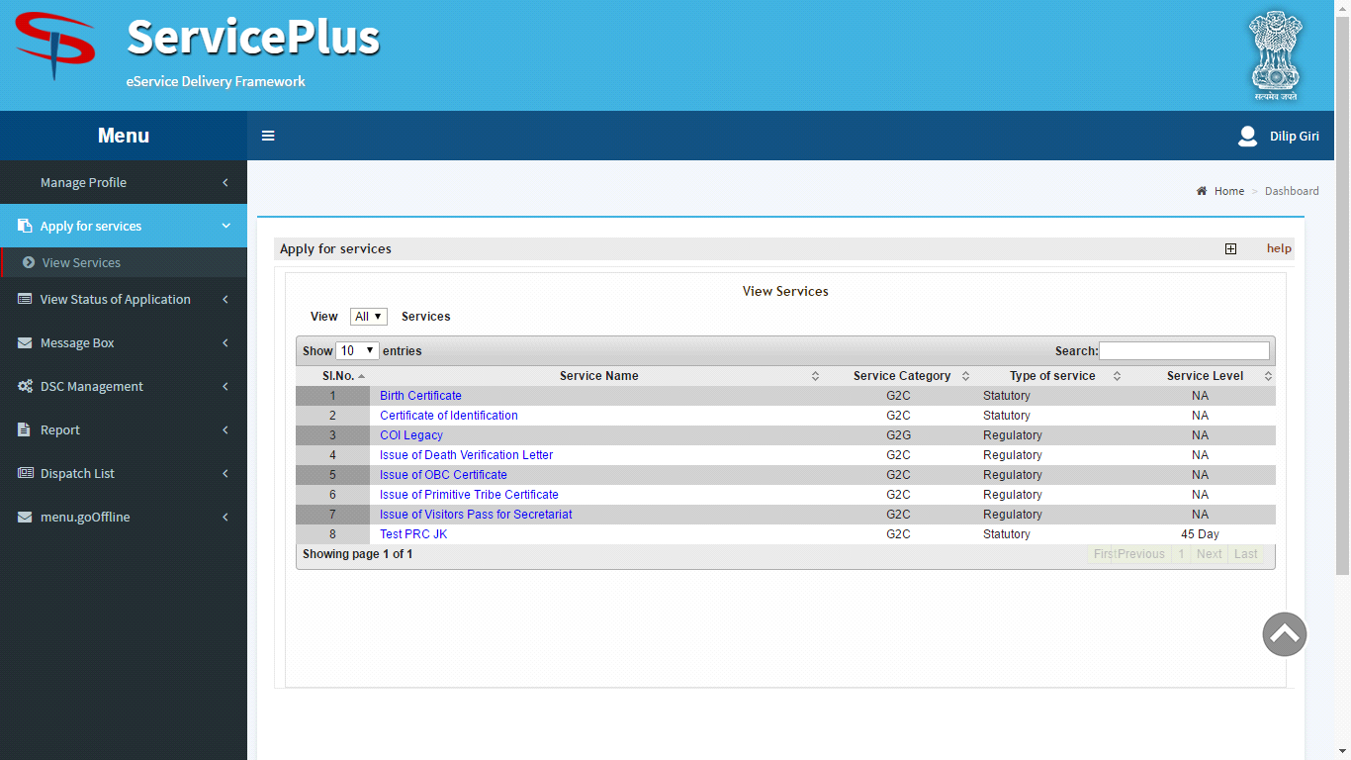
Apply for Services.

Slide 19
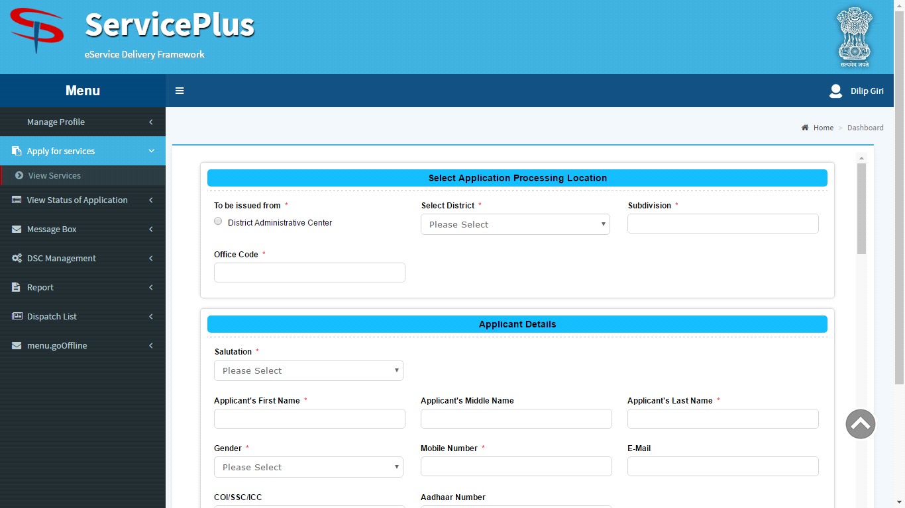
Fill in the details:

Slide 20
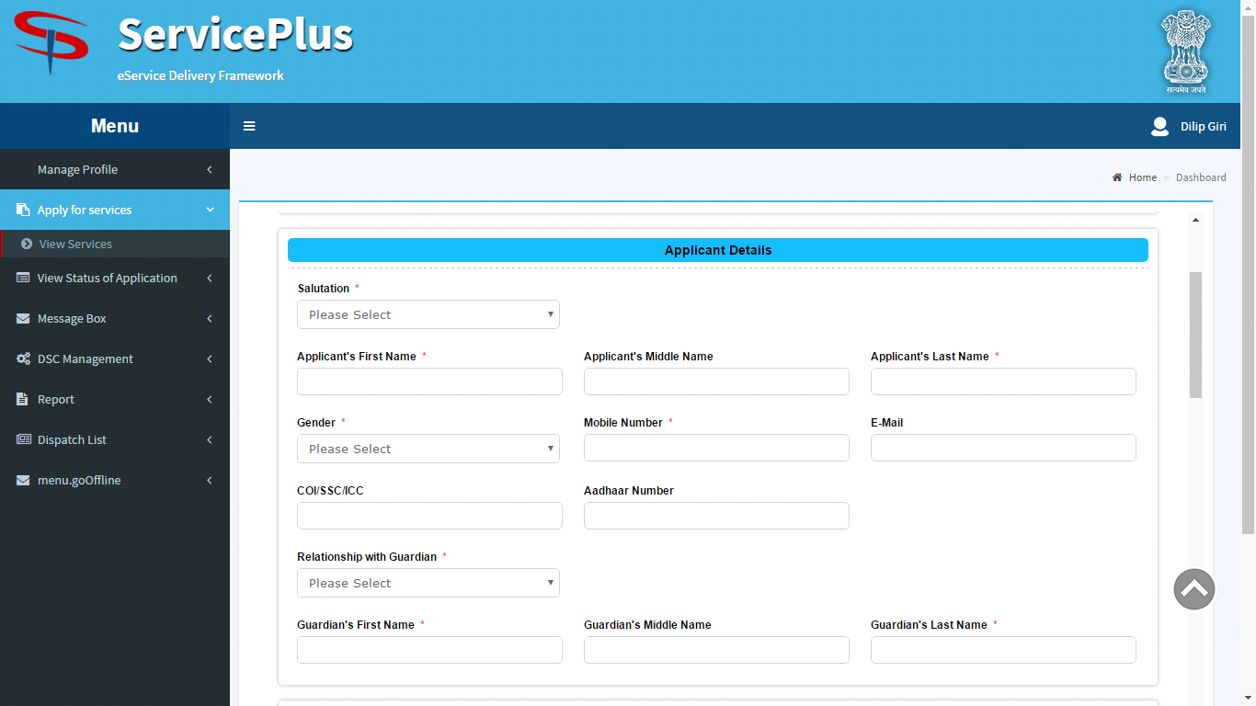
Fill in the details:

Slide 21
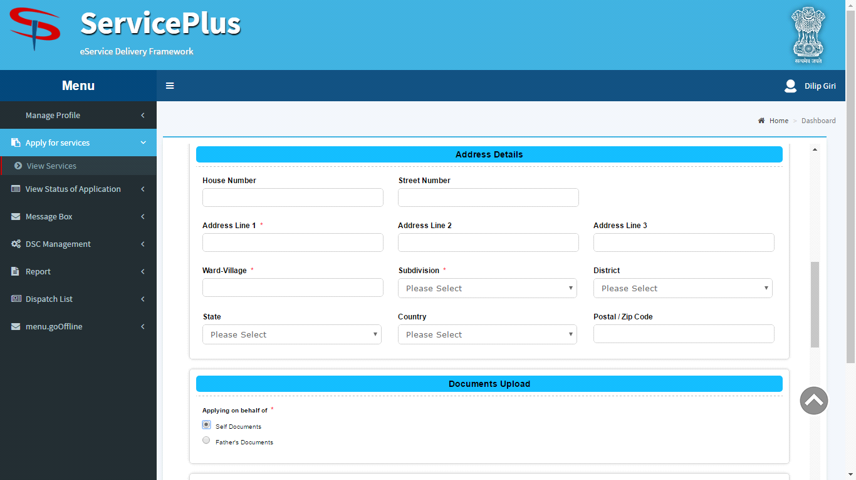
Fill in the details

Slide 22
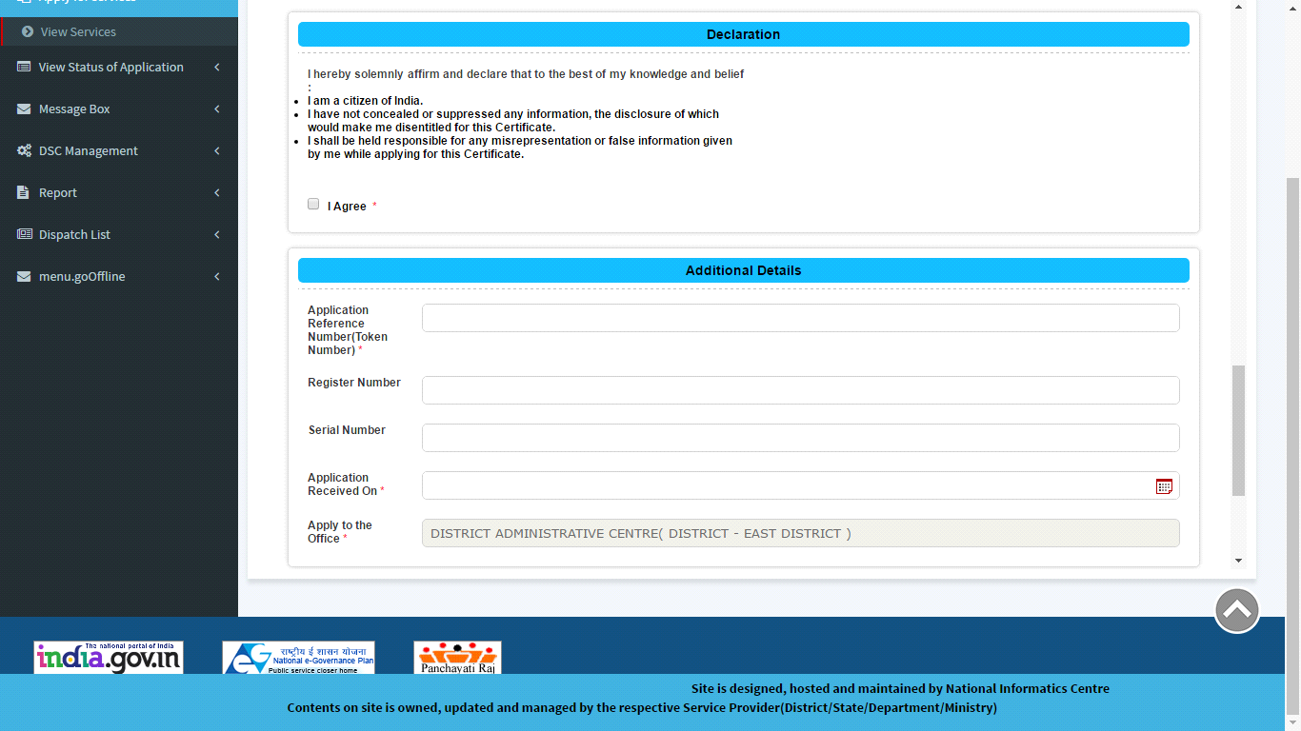
Declaration:

Slide 23
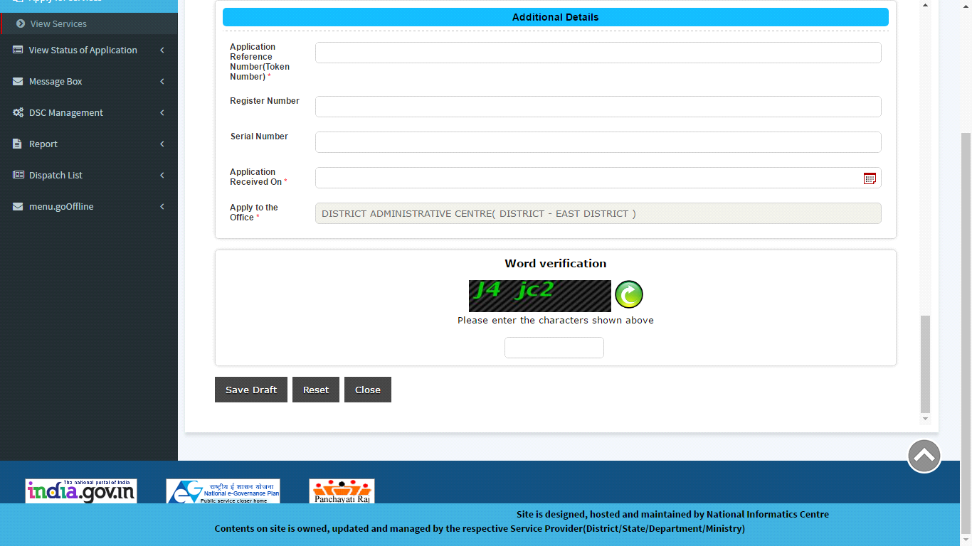
Fill the additional details:

Slide 24
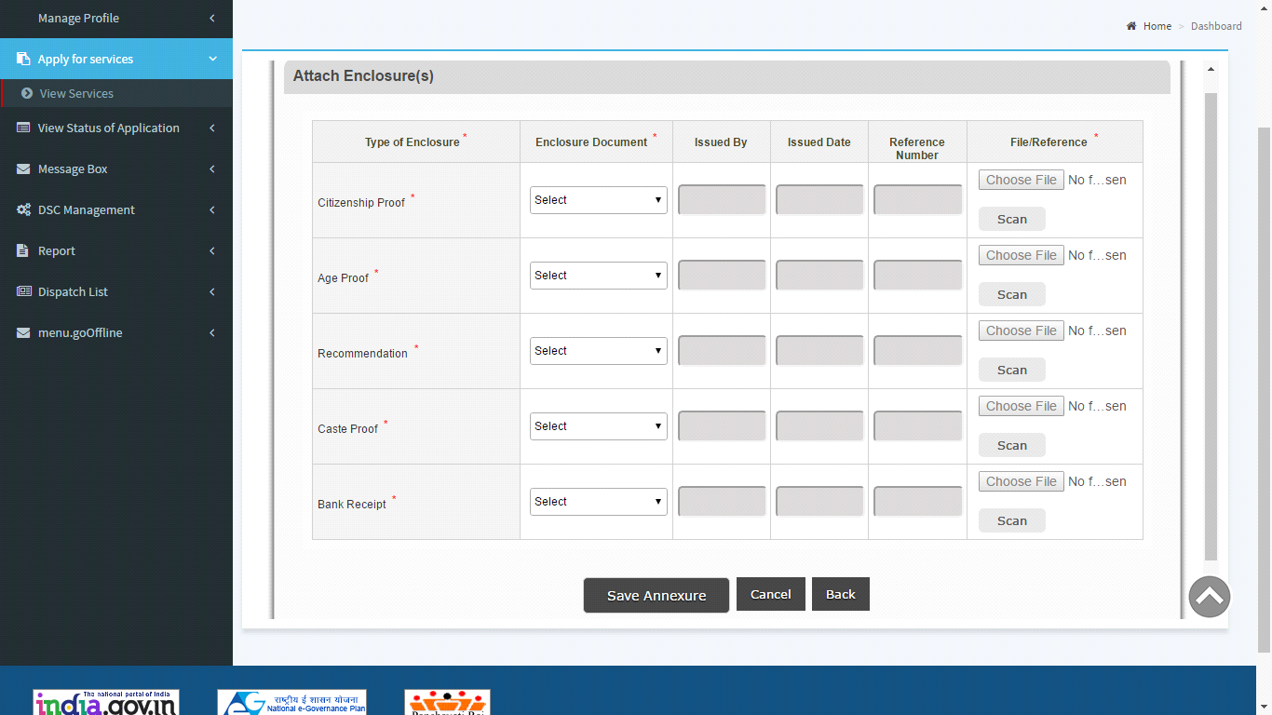
Attach Enclosure:

Slide 25
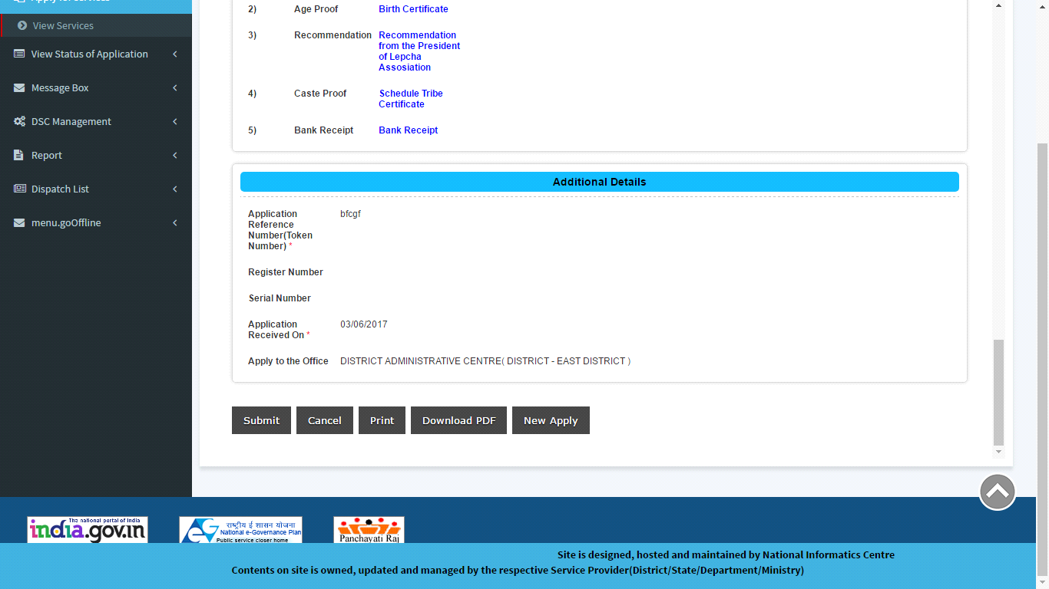
Submit the application:

Slide 26
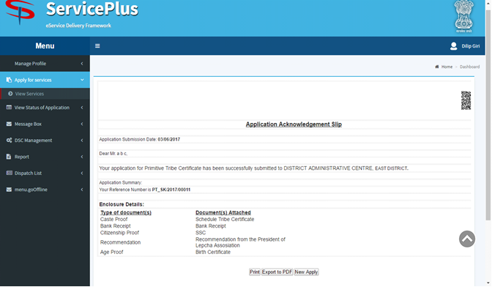
Acknowledgement slip

Slide 27
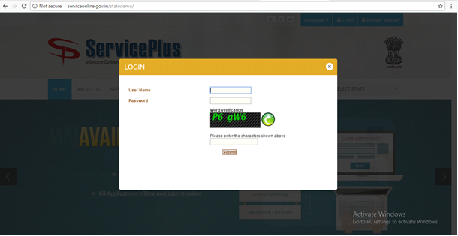
LDC
LOGIN

Slide 28
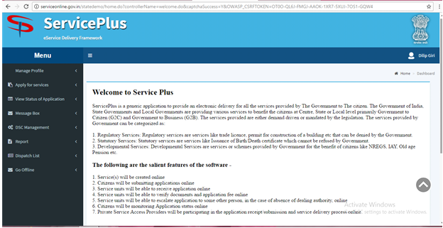
Home Page

Slide 29
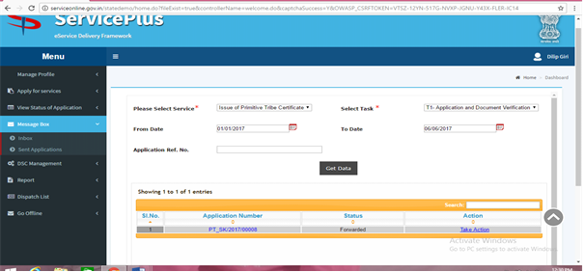
Getting the application:

Slide 30
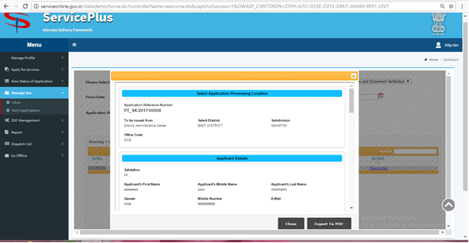
Viewing the application:

Slide 31
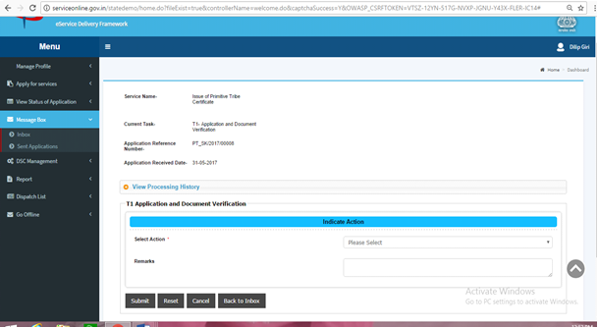
Take action:

Slide 32
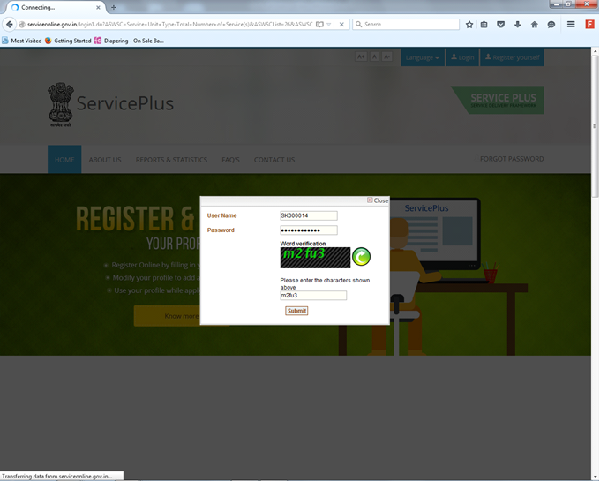
DC/SDM
LOGIN

Slide 33
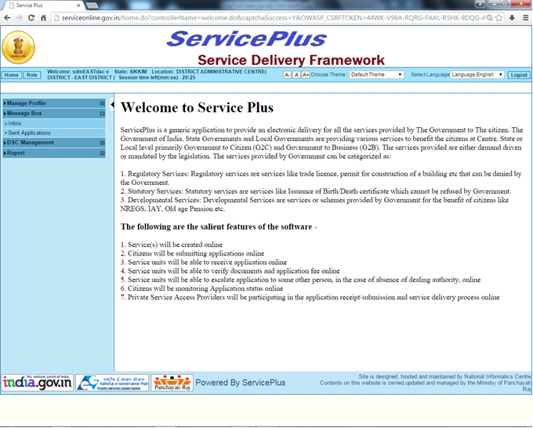
Home Page

Slide 34
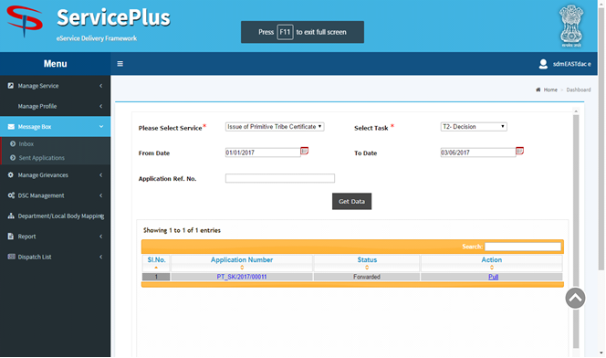
Getting the application:

Slide 35
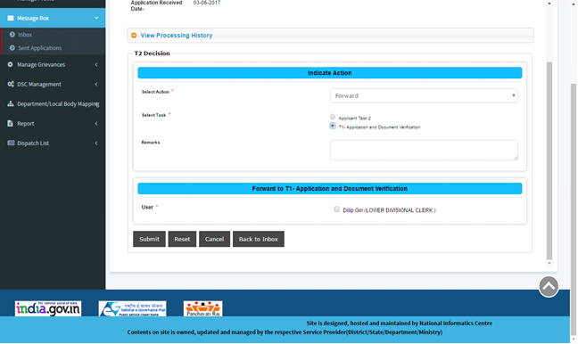
Returning the application to the LDC:

Slide 36
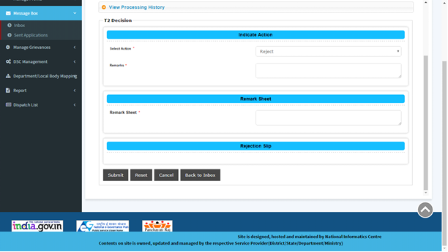
Rejecting the application

Slide 37
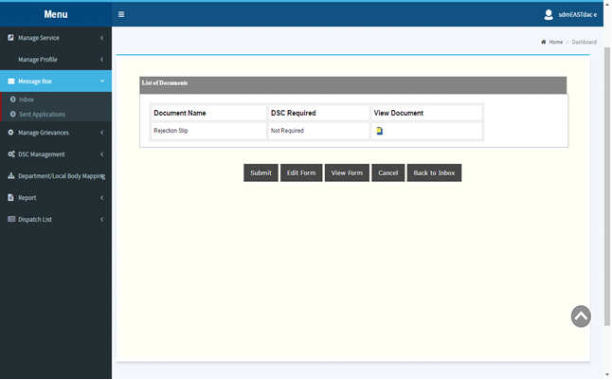
Generation of rejection slip:

Slide 38
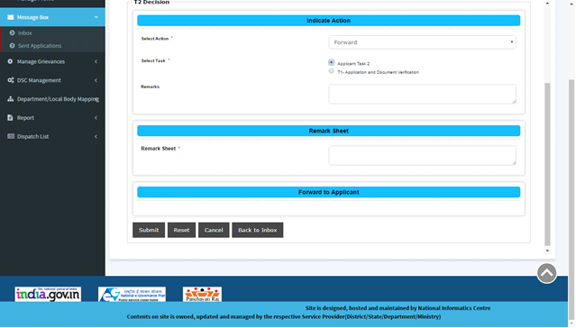
Returning the Application to Applicant:

Slide 39
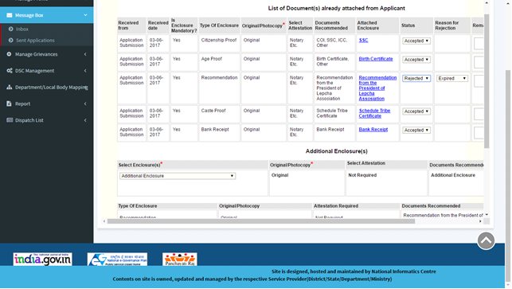
Rejecting an enclosure:

Slide 40
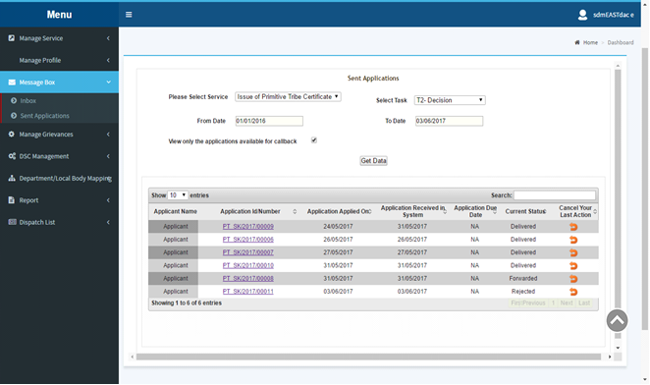
Calling back a rejected application:

Slide 41
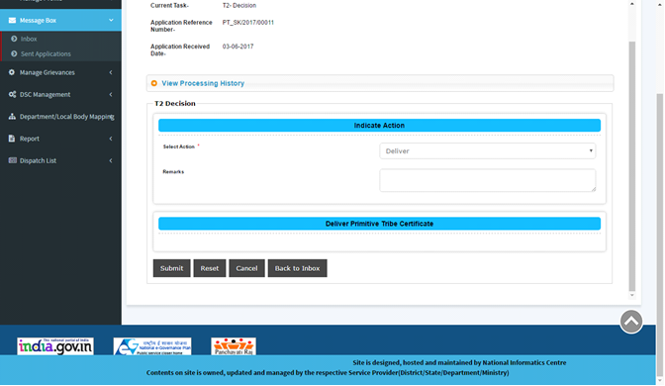
Service delivery:

Slide 42
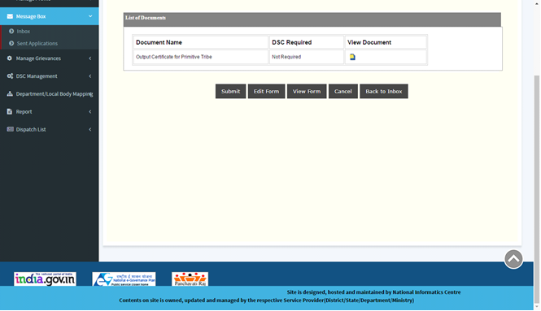
View document:

Slide 43
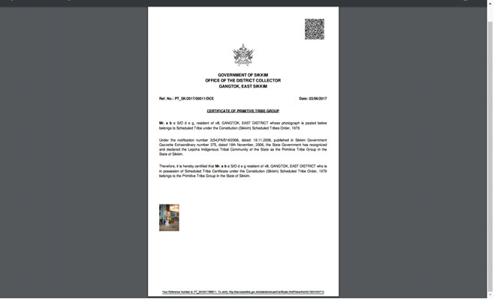
Output certificate:

Slide 44
Thank you :-)

